Slide 1
Employee Data Analysis using Excel
STUDENT NAME:Abinaya Bharathy R
REGISTER NO: 312216895
DEPARTMENT: B. COM(GENERAL)
COLLEGE: SHRI KRISHNASWAMY COLLEGE FOR WOMEN

Slide 2
PROJECT TITLE
SALARY AND COMPENSATION ANALYSIS THROUGH EXCEL DATA MODELLING

Slide 3


AGENDA
Problem Statement
Project Overview
End Users
Our Solution and Proposition
Dataset Description
Modelling Approach
Results and Discussion
Conclusion
3/21/2024 Annual Review

Slide 4

PROBLEM STATEMENT
The organization is facing challenges in ensuring fair and competitive compensation across various departments. There is a need for an in-depth analysis of salary distribution, identification of any disparities, and recommendations for improvements to align with industry standards.

Slide 5

PROJECT OVERVIEW
This project aims to analyze the existing salary and compensation data using Excel data modeling techniques. The goal is to develop insights that can help in making data-driven decisions regarding salary adjustments, promotions, and benefits allocation
.

Slide 6

WHO ARE THE END USERS?
HR Department: To use the insights for refining compensation policies. Management: To ensure equitable and competitive salary distribution. Finance Team: To allocate budget efficiently and plan for salary adjustments. Employees: Indirectly, to ensure fair compensation aligned with industry standards.

Slide 7

OUR SOLUTION AND ITS VALUE PROPOSITION
We propose to create a comprehensive Excel-based model that allows the organization to: Analyze current salary distributions. Compare salaries against industry benchmarks. Identify disparities across departments, genders, and roles. Forecast the financial impact of proposed salary adjustments. Develop recommendations for aligning compensation with market standards.

Slide 8
Dataset Description
The data used for this analysis includes: Employee Data: Age, gender, department, years of experience, education level, role, and current salary. Industry Benchmark Data: Average salaries for similar roles across the industry. Financial Data: Budget allocations for salaries, historical salary adjustments, and benefits.

Slide 9

THE "WOW" IN OUR SOLUTION
Model Outputs: The regression model highlights the most significant predictors of salary, such as years of experience and education level. Scenario Analysis: Shows the potential impact on the overall budget if salaries are adjusted to match industry standards or to correct identified disparities.
3/21/2024 Annual Review
9

Slide 10
MODELLING
Descriptive Analysis: Use pivot tables and charts to visualize salary distribution by department, role, and other factors. Comparative Analysis: Compare internal salary data against industry benchmarks using VLOOKUP and INDEX-MATCH functions. Regression Analysis: Build a regression model to understand the factors influencing salary levels. Scenario Analysis: Use What-If Analysis to simulate the impact of different compensation strategies. Visualization: Develop dashboards to present key findings and recommendations.
10

Slide 11
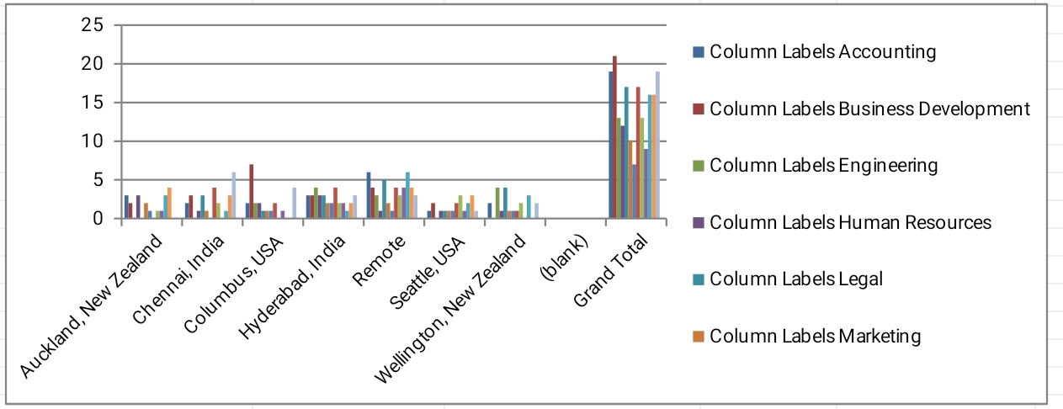
RESULTS
11

Slide 12
conclusion
The Excel-based salary and compensation analysis model provides valuable insights into current salary structures and disparities within the organization. By implementing the recommended adjustments, the organization can ensure fair, competitive, and equitable compensation for all employees, which could enhance employee satisfaction and retention. This outline should help you structure a report or presentation on salary and compensation analysis using Excel data modeling.

